Slide 1
The Influence of Dependent Types
Stephanie Weirich
University of Pennsylvania

Slide 2
Dependent Haskell
A set of compiler extensions for the GHC compiler, which provides the ability to program as if the language had "dependent types"
{-# LANGUAGE TypeOperators, DataKinds, KindSignatures, TypeFamilies, PolyKinds, TypeInType, UndecidableInstances, GADTs, RankNTypes, ScopedTypeVariables, TypeApplications, AllowAmbiguousTypes, TemplateHaskell, InstanceSigs, FunctionalDependencies, TypeFamilyDependencies FlexibleContexts, TypeSynonymInstances, FlexibleInstances, MultiParamTypeClasses #-}
Notes:
There is no fixed set of extensions that is called "Dependent Haskell"

Slide 3
Goals of talk
"What have you done to Haskell?" Showcase ~10 years of GHC language extensions that conspire to make GHC "dependently-typed"
"What about Agda? or Coq? or Idris?" Showcase benefits of working on Dependent Types in context of the Haskell language (type classes, TemplateHaskell, type inference, industrial-strength compiler, awesome collaborators)
"What's next?" Show how we can go further with Dependent Haskell

Slide 4
Awesome Collaborators

Slide 5
Four Features of Dependent Types
Types compute
Indices constrain data
Dependent arguments can be relevant
Equivalence matters
Notes:
made it hard to read so that you'll pay attention!

Slide 6
Why Dependent Types?
Verification: Dependent types express application-specific program invariants that are beyond the scope of existing type systems
Expressiveness: Dependent types enable flexible interfaces, of particular importance to embedded DSLs, generic programming and metaprogramming.
Uniformity: The same syntax and semantics is used for computations, specifications and proofs
Everything is “just programming”
Ultimate goal: making the type checker more informative
Dependent types can seem mysterious … but types dispel mysteries

Slide 7
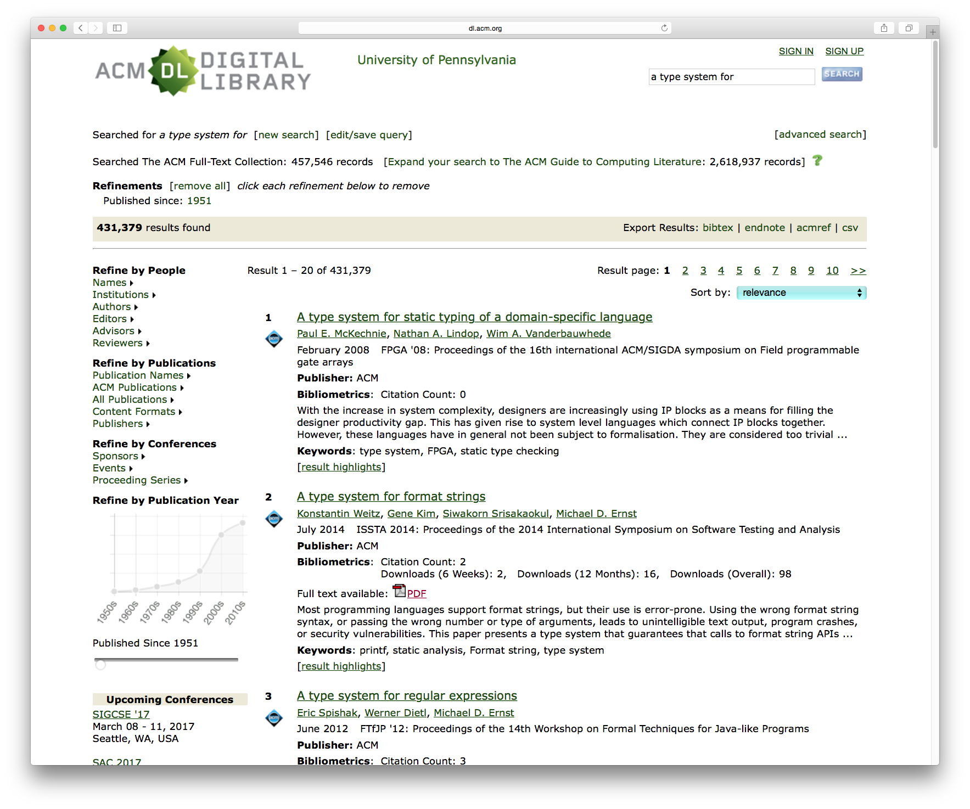

Slide 8
A type system for regular expressions
Challenge:
Extract the parts of a file path such as
"dth/popl17/Regexp.hs"
Basename "Regexp"
Extension "hs"
Directories in path "dth" "popl17"
Return all results in a data structure
Type system allows only "sensible" access to results

Slide 9
A type system for regular expressions
Example: extract the parts of a file path such as
"dth/popl17/Regexp.hs"
/?((?P<d>[^/]+)/)*(?P<b>[^/.]+)(?P<e>\..*)?
/?((?P<d>[^/]+)/)*(?P<b>[^/.]+)(?P<e>\..*)?
/?((?P<d>[^/]+)/)*(?P<b>[^/.]+)(?P<e>\..*)?
/?((?P<d>[^/]+)/)*(?P<b>[^/.]+)(?P<e>\..*)?
/?((?P<d>[^/]+)/)*(?P<b>[^/.]+)(?P<e>\..*)?
/?((?P<d>[^/]+)/)*(?P<b>[^/.]+)(?P<e>\..*)?
/?((?P<d>[^/]+)/)*(?P<b>[^/.]+)(?P<e>\..*)?
/?((?P<d>[^/]+)/)*(?P<b>[^/.]+)(?P<e>\..*)?
/?((?P<d>[^/]+)/)*(?P<b>[^/.]+)(?P<e>\..*)?
Syntax like Python, but different semantics
Only named capture groups, not numbered
Implementation based on "Martin Sulzmann, Kenny Zhuo Ming Lu. Regular expression sub-matching using partial derivatives."
All code available at
http://www.github.com/sweirich/dth/popl17/

Slide 10
Regular Expression Submatching
Extract the parts of a filepath "dth/popl17/Regexp.hs"
ghci> let md = match path "dth/popl17/Regexp.hs"
ghci> isJust md
True
ghci> let d = fromJust md
ghci> d
{b="Regexp", d=["dth","popl17"], e=Just ".hs"}
ghci> get @"b" d
"Regexp"
ghci> get @"a" d
<interactive>:28:1: error:
• a not found in
b, d, e
/?((?P<d>[^/]+)/)*(?P<b>[^/.]+)(?P<e>\..*)?
Notes:
Do this in the demo
Mention TypeApplication syntax (with the @s)

Slide 11
Type aware implementation
ghci> let path = [re|/?((?P<d>[^/]+)/)*(?P<b>[^/.]+)(?P<e>\..*)?|]
ghci> let d = fromJust (match path "dth/popl16/Regexp.hs")
ghci> :t d
ghci> Dict '['("b", 'Once),'("d", 'Many), '("e", 'Opt)]
ghci> :t path
path :: R '['("b", 'Once), '("d", 'Many), '("e", 'Opt)]
The type of the regular expression tells us where submatches occur
The type of the dictionary describes its domain and range
Notes:
Do this in the demo
Mention 's in promoted data constructors
Mention that the type of d and path are inferred

Slide 12
Types Compute
We can use dependent types to implement a domain-specific compile-time analysis

Slide 13
How does this work?
ghci> let path =
[re|/?((?P<d>[^/]+)/)*(?P<b>[^/.]+)(?P<e>\..*)?|]
ghci> :t path
path :: R '['("b", 'Once), '("d", 'Many), '("e", 'Opt)]
ghci> let path = ralt rempty (rchars "/") `rseq` rstar (rmark @"d" (rplus (rnot "/")) `rseq` rchars "/") `rseq` rmark @"b" (rplus (rnot "/.")) `rseq` ralt rempty (rmark @"e" (rchars "." `rseq` rstar rany))
ghci> :t path
path :: R '['("b", 'Once), '("d", 'Many), '("e", 'Opt)]
DataKinds [Yorgey, Weirich, Cretin, Peyton Jones, Magalhães TLDI 2012]
Type-level strings [Diatcki, HS 2015]
TemplateHaskell [Sheard & Peyton Jones, HW 2002]
TypeApplications [Eisenberg, Weirich, Hamidhasan, ESOP 2016]
Notes:
First step is a TemplateHaskell parser, which statically checks the syntax of the regular expression

Slide 14
Define the interface with types
type R s :: Type
-- For each capture group, how many times does
-- it appear in the regexp?
-- accepts empty string only
rempty :: R Empty
-- accepts single char only
rchar :: Char -> R Empty
-- alternative r₁|r₂
ralt :: R s1 -> R s2 -> R (Alt s1 s2)
-- sequence r₁r₂
rseq :: R s1 -> R s2 -> R (Merge s1 s2)
-- marked subexpression
rmark :: forall n s. R s -> R (Merge (One n) s)
-- iteration r*
rstar :: R s -> R (Repeat s)
[Schrijvers, Peyton Jones, Chakravarty, Sulzmann, ICFP 2008]

Slide 15
Examples
ghci> r1 = rmark @"a" rany
ghci> :t r1
r1 :: R '['("a", 'Once)]
ghci> r2 = rmark @"b" rany
ghci> :t r2
r2 :: R '['("b", 'Once)]
ghci> :t r1 `rseq` r1
r1 `rseq` r1 :: R '['("a", 'Many)]
ghci> :t r1 `rseq` r2
r1 `rseq` r2 :: R '['("a", 'Once), '("b", 'Once)]
ghci> :t r1 `ralt` r1
r1 `ralt` r1 :: R '['("a", 'Once)]
ghci> :t r1 `ralt` r2
r1 `ralt` r2 :: R '['("a", 'Opt), '("b", 'Opt)]
ghci> :t rstar r1
rstar r1 :: R '['("a", 'Many)]
Notes:
Do this in the emacs buffer

Slide 16
Computing with types
Represent maps by lists of pairs,
ordered by first component
type Occ = Once | Opt | Many
type U = [(Symbol,Occ)]
type Empty = '[]
type One n = '[ '(n, Once) ]
type family Merge (a :: U) (b :: U) :: U where
Merge s '[] = s
Merge '[] s = s
Merge ('(n1,o1):t1) ('(n2,o2):t2) =
If (n1 :== n2) ('(n1, 'Many) : Merge t1 t2)
(If (n1 :<= n2) ('(n1, o1) : Merge t1 (n2:t2))
('(n2, o2) : Merge (n1:t1) t2))
Datatype promotion allows data
constructors to be used in types
GHC.TypeLits allows strings to be
used in type-level computations
Notes:
Mention ordering (using the equality and <= for type level strings)

Slide 17
TemplateHaskell to promote type functions
$(singletons [d|
empty :: U
empty = []
one :: Symbol -> U
one s = [(s,Once)]
merge :: U -> U -> U
merge m [] = m
merge [] m = m
merge (e1@(n1,o1):t1) (e2@(n2,o2):t2) =
if n1 == n2 then (n1, Many) : merge t1 t2
else if n1 <= n2 then e1 : merge t1 (e2:t2)
else e2 : merge (e1:t1) t2
|])
[Eisenberg and Stolarek, HS 2014]

Slide 18
GHC's take for type-level computation
Type functions are arbitrary computation and need not be terminating
Type inference backwards compatible with Hindley Milner type system
Type-level functions assumed non-injective, often need explicit type applications to avoid ambiguity
What's next for GHC? Anonymous type-level functions, more flexibility in higher-order polymorphism

Slide 19
Indices constrain data
We can use compile-time data to define type structure

Slide 20
How does this work?
ghci> :t d
Dict '['("b", 'Once),'("d", 'Many), '("e", 'Opt)]
ghci> get @"e" d
Just "hs"
ghci> get @"a" d
<interactive>:28:1: error:
• a not found in
b, d, e
data Dict :: U -> Type where
Nil :: Dict '[]
(:>) :: Entry '(n,o) -> Dict tl -> Dict ('(n,o) : tl)
data Entry :: (Symbol,Occ) -> Type where
Entry :: OccType o -> Entry '(s,o)
type family OccType (o :: Occ) = (res :: Type) | res -> o where
OccType Once = String
OccType Opt = Maybe String
OccType Many = [String]
TypeFamilyDependencies [Stolarek, Peyton Jones, Eisenberg HS 2016]
GADTs [Peyton Jones, Vytiniotis, Washburn, Weirich ICFP 2006]

Slide 21
Type Constrains the data
At compile-time, type checker can know that @"b" is the first entry in the list
And that @"a" is not present
data Dict :: U -> Type where
Nil :: Dict '[]
(:>) :: Entry '(n,o) -> Dict tl -> Dict ('(n,o) : tl)
data Entry :: (Symbol,Occ) -> Type where
Entry :: OccType o -> Entry '(s,o)
d :: Dict '['("b", 'Once),'("d", 'Many), '("e", 'Opt)]
d = Entry @"b" "…" :> Entry @"d" ["…", "…"]
:> Entry @"e" (Just "..) :> Nil

Slide 22
Static data structure access
Overloaded general purpose accessor for records
Compile-time constraint solving, guided by a type-level "Find" function that calculates offset into the dictionary
If Find function fails at compile time, custom type error is triggered and reported to user.
get :: Has n r a => r -> a
Custom Type Errors [Augusstson, HS 2015]
ClosedTypeFamilies [Eisenberg, Peyton Jones, Weirich POPL 2014]
TypeInType [Weirich, Hsu, Eisenberg, ICFP 2013]

Slide 23
Dependent arguments can be computationally relevant
We can use type-level data at runtime

Slide 24
How does this work?
data Dict :: U -> Type where
Nil :: Dict '[]
(:>) :: Entry '(n,o) -> Dict tl -> Dict ('(n,o) : tl)
data Entry :: (Symbol,Occ) -> Type where
Entry :: OccType o -> Entry '(s,o)
ghci> d = Entry @"b" "Regexp"
:> Entry @"d" ["dth", "popl17"]
:> Entry @"e" (Just "hs") :> Nil
ghci> show d
{b="Regexp",d=["dth","popl17"],e=Just ".hs"}

Slide 25
Dependent types
showEntry :: Π n -> Π o -> Entry '(n,o) -> String
showEntry n o (Entry ss) =
show n ++ "=" ++ showData o ss where
showData :: Π o -> OccType o -> String
showData Once ss = show ss -- for String
showData Opt ss = show ss -- for [String]
showData Many ss = show ss -- for Maybe String

Slide 26
Singletons for runtime access
type Π = Sing
showEntry :: Π n -> Π o -> Entry '(n,o) -> String
showEntry n o (Entry ss) =
show n ++ "=" ++ showData o ss where
showData :: Π o -> OccType o -> String
showData SOnce ss = show ss -- for String
showData SOpt ss = show ss -- for [String]
showData SMany ss = show ss -- for Maybe String
data instance Sing (o :: Occ) where
SOnce :: Sing Once
SOpt :: Sing Opt
SMany :: Sing Many
[Eisenberg and Weirich, HS 2012]

Slide 27
How does this work?
let r = [re|((?P<a>.)(?P<b>.))*|]
ghci> :t r
r :: R '['("a", 'Many), '("b", 'Many)]
ghci> match r ""
Just {a=[],b=[]}
nils :: Π s -> Dict (Repeat s)
nils [] = Nil
nils ((_,_):s) = Entry [] :> nils s
nils :: Sing s -> Dict (Repeat s)
nils SNil = Nil
nils (SCons (STuple2 _ _) s) =
Entry [] :> nils s

Slide 28
How does this work?
let r = [re|((?P<a>.)(?P<b>.))*|]
ghci> :t r
r :: R '['("a", 'Many), '("b", 'Many)]
ghci> match r ""
Just {a=[],b=[]}
nils :: Π s -> Dict (Repeat s)
nils [] = Nil
nils ((_,_):s) = Entry [] :> nils s
nils :: Sing s -> Dict (Repeat s)
nils SNil = Nil
nils (SCons (STuple2 _ _) s) =
Entry [] :> nils s

Slide 29
Singletons are easyish
Uniform type for all singletons, indexed by kinds
"Π a -> b" is "Sing a -> b"
Type class supplies Singletons via type inference
Boilerplate can be automated via TemplateHaskell
type Sing (a :: k) …
class SingI (a :: k) where
sing :: Sing a

Slide 30
Equivalence matters
Type checking depends on the definition of program equality

Slide 31
Regular Expression datatype (no indices)
data R where
Rempty :: R -- ε (accepts empty string)
Rchars :: [Char] -> R -- accepts single char
Ralt :: R -> R -> R -- alternative r₁|r₂
Rseq :: R -> R -> R -- sequence r₁r₂
Rstar :: R -> R -- iteration r*
Rvoid :: R -- ϕ (always fails)
Rmark :: String -> R -> R
rseq :: R -> R -> R
rseq Rvoid r2 = Rvoid
rseq r1 Rvoid = Rvoid
rseq Rempty r2 = r2
rseq r1 Rempty = r1
rseq r1 r2 = Rseq r1 r2
"Smart constructors" optimize regexp creation

Slide 32
Regexps with type indices
data R s where
Rempty :: R Empty
Rchar :: Char -> R Empty
Ralt :: R s1 -> R s2 -> R (Alt s1 s2)
Rseq :: R s1 -> R s2 -> R (Merge s1 s2)
Rstar :: R s -> R s
Rvoid :: R s
Rmark :: Π n -> String -> R s -> R (Merge (One n) s)
rseq :: R s1 -> R s2 -> R (Merge s1 s2)
rseq Rvoid r1 = Rvoid
rseq r1 Rvoid = Rvoid
rseq Rempty r1 = r1
rseq r1 REmpty = r1
rseq r1 r2 = Rseq r1 r2
-- needs Rvoid :: forall s. R s
-- Merge Empty s2 ~ s2 by def
-- Merge s1 Empty ~ s1 by def

Slide 33
Regexps with types and proofs?
rstar :: R s -> R (Repeat s)
rstar Rempty = Rempty -- need: Repeat Empty ~ Empty
rstar (Rstar s) = Rstar s -- oops!
rstar s = Rstar s
• Could not deduce: Repeat s ~ s
from the context: s ~ Repeat s1
Need to know that Repeat (Repeat s1) ~ Repeat s1
Not true by definition.
Notes:
~ is equality in Haskell

Slide 34
Equality constraints solve the problem
class (Repeat s ~ Repeat (Repeat s)) => Wf (s :: U)
instance Wf '[]
instance (Wf s) => Wf (n : s)
data R s where
Rempty :: R Empty
Rchar :: Char -> R Empty
Ralt :: (Wf s1, Wf s2) =>
R s1 -> R s2 -> R (Union s1 s2)
Rseq :: (Wf s1, Wf s2) =>
R s1 -> R s2 -> R (Union s1 s2)
Rstar :: (Wf s) => R s -> R s
Rvoid :: R s
rstar :: Wf s => R s -> R (Repeat s)
rstar (Rstar s1) = Rstar s1
data Color = R | B
data Tree = E | T Tree A Tree
insert :: Tree -> A -> Tree
insert s x = blacken (ins s)
where ins E = T R E x E
ins s@(T color a y b)
| x < y = balance color (ins a) y b
| x > y = balance color a y (ins b)
| otherwise = s
blacken (T _ a x b) = T B a x b
Get Haskell to prove
this property for us
Make sure it is available for all indices we use

Slide 35
Constraints to the rescue
class (Repeat s ~ Repeat (Repeat s)) => Wf (s :: U)
instance Wf '[]
instance Wf s => Wf ('(n, o) : s)
-- Make sure ALL type lists satisfy this constraint
Rstar :: Wf s => R s -> R (Repeat s)
rstar :: Wf s => R s -> R (Repeat s)
rstar Rempty = Rempty
rstar (Rstar s1) = Rstar s1
-- (s1 :: R s1) and (Wf s1, s ~ Repeat s1)
rstar s = Rstar s

Slide 36
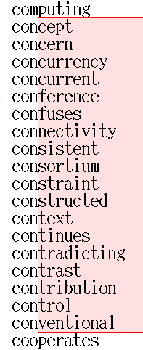
Submatching using Brzozowski Derivatives
Brzozowski derivative (on red background) of a dictionary string set with respect to "con". From Wikipedia

Slide 37
Regexp derivative matching
ghci> r = [re|(?P<b>..)(?P<a>..)|]
ghci> r1 = deriv r 'P'
-- (?P<b:"P">.)(?P<a>..)
ghci> r2 = deriv r1 'O'
-- (?P<b:"PO">ε)(?P<a>..)
ghci> r3 = deriv r2 'P'
-- (?P<b:"PO">ε)(?P<a:"P">.)
ghci> r4 = deriv r3 'L'
-- (?P<b:"PO">ε)(?P<a:"PL">ε)
ghci> extract r4
Just {a="PL",b="PO"}

Slide 38
Regular Expression Derivatives w/ matching
match :: R -> String -> Bool
match r w = extract (foldl' deriv r w)
deriv :: R -> Char -> R
deriv (Rchar s) c | c == s = rempty
deriv (Rseq r1 r2) c =
ralt (rseq (deriv r1 c) r2)
(rseq (markEmpty r1) (deriv r2 c))
deriv (Rseq r1 r2) c = rseq (deriv r1 c) r2
deriv (Ralt r1 r2) c = ralt (deriv r1 c) (deriv r2 c)
deriv (Rstar r) c = rseq (deriv r c) (rstar r)
deriv (Rmark n w r) c = Rmark n (w ++ [c]) (deriv r c)
deriv _ c = Rvoid
data Color = R | B
data Tree = E | T Tree A Tree
insert :: Tree -> A -> Tree
insert s x = blacken (ins s)
where ins E = T R E x E
ins s@(T color a y b)
| x < y = balance color (ins a) y b
| x > y = balance color a y (ins b)
| otherwise = s
blacken (T _ a x b) = T B a x b
Smart constructors optimize new regexp
on the fly, only keeping marked strings

Slide 39
Derivatives with types, almost
deriv :: Wf s => R s -> Char -> R s
deriv (Rchar s) c | c == s = rempty
deriv (Rseq r1 r2) c =
ralt (rseq (deriv r1 c) r2) -- needs: s ~ Alt s s
(rseq (markEmpty r1) (deriv r2 c))
deriv (Rseq r1 r2) c = rseq (deriv r1 c) r2
deriv (Ralt r1 r2) c = ralt (deriv r1 c) (deriv r2 c)
deriv (Rstar r) c = rseq (deriv r c) (rstar r)
-- needs: Merge s (Repeat s) ~ Repeat s
deriv (Rmark n w r) c = Rmark n (w ++ [c]) (deriv r c)
deriv _ c = Rvoid

Slide 40
Another easy proof
class (s ~ Alt s s,
Merge s (Repeat s) ~ Repeat s,
Repeat s ~ Repeat (Repeat s)) => Wf (s :: U)
instance Wf '[]
instance (WfOcc o, Wf s) => Wf ('(n, o) : s)
class (o ~ Max o o) => WfOcc (o :: Occ)
instance WfOcc Once
instance WfOcc Opt
instance WfOcc Many

Slide 41
What's next for Dependent Haskell?
Is this all cleverness or is it actually useful?

Slide 42
What's next
Type checking with properties is similar to extensional type theory
See Vilhelm Sjoeberg's dissertation integrates congruence closure algorithm with full-spectrum dependent types
However, would be good to have a more general mechanism, interacting with custom solvers

Slide 43
What's next
A real Pi type for Haskell is not far away
Semantically, very few changes
Richard Eisenberg's dissertation defines core language with Pi type, extends type inference algorithm
Antoine Voizard, Pedro Avezedo de Amorim and I are very close to a mechanical proof of the type soundness of core language

Slide 44
Why are we doing this?
Deep specifications for software

Slide 45
Four Influences from Dependent Type Theory
Types contain computation
Type indices constrain data
Dependent arguments can be relevant
Type checking requires program equivalence
Notes:
made it hard to read so that you'll pay attention!

Slide 46
Summary

Slide 48
fin

Slide 49
Derivatives with types
deriv :: Wf s => R s -> Char -> R s
deriv (Rchar s) c =
if c == s then rempty else Rvoid
deriv Rempty c = Rvoid
deriv (Rseq r1 r2) c | nullable r1 =
ralt (rseq (deriv r1 c) r2) r1' where
r1' = rseq (markEmpty r1) (deriv r2 c)
deriv (Rseq r1 r2) c = rseq (deriv r1 c) r2
deriv (Ralt r1 r2) c = ralt (deriv r1 c) (deriv r2 c)
deriv (Rstar r) c = rseq (deriv r c) (rstar r)
deriv Rvoid c = Rvoid
deriv (Rmark n w r) c = Rmark n (w ++ [c]) (deriv r c)
data Color = R | B
data Tree = E | T Tree A Tree
insert :: Tree -> A -> Tree
insert s x = blacken (ins s)
where ins E = T R E x E
ins s@(T color a y b)
| x < y = balance color (ins a) y b
| x > y = balance color a y (ins b)
| otherwise = s
blacken (T _ a x b) = T B a x b
Now type checker
has access to
s ~ Union s s

Slide 50
Extraction
extract :: Wf s => R s -> Result s
extract Rempty = Just Nil
extract (Rseq r1 r2) = both (extract r1) (extract r2)
extract (Ralt r1 r2) = first (extract r1) (extract r2)
extract (Rstar r) = first (Just Nil) (extract r)
extract (Rmark n s r) = both markResult (extract r) where
markResult = Just (Entry n [s] :> Nil)
extract _ = Nothing
both :: Result s1 -> Result s2 -> Result (Union s1 s2)
first :: Result s1 -> Result s2 -> Result (Union s1 s2)
data Color = R | B
data Tree = E | T Tree A Tree
insert :: Tree -> A -> Tree
insert s x = blacken (ins s)
where ins E = T R E x E
ins s@(T color a y b)
| x < y = balance color (ins a) y b
| x > y = balance color a y (ins b)
| otherwise = s
blacken (T _ a x b) = T B a x b

Slide 51
both
both :: Result s1 -> Result s2 -> Result (Union s1 s2)
both (Just xs) (Just ys) = Just $ combine xs ys
both _ _ = Nothing
combine :: Dict s1 -> Dict s2 -> Dict (Union s1 s2)
combine Nil Nil = Nil
combine Nil b = b
combine b Nil = b
combine (e1@(Entry n1 ss1) :> t1) (e2@(Entry n2 ss2) :> t2) =
case n1 %:== n2 of
STrue -> Entry n1 (ss1 ++ ss2) :> combine t1 t2
SFalse -> case n1 %:<= n2 of
STrue -> e1 :> combine t1 (e2 :> t2)
SFalse -> e2 :> combine (e1 :> t1) t2
data Color = R | B
data Tree = E | T Tree A Tree
insert :: Tree -> A -> Tree
insert s x = blacken (ins s)
where ins E = T R E x E
ins s@(T color a y b)
| x < y = balance color (ins a) y b
| x > y = balance color a y (ins b)
| otherwise = s
blacken (T _ a x b) = T B a x b

Slide 52
first & singletons
first :: forall s1 s2. (SingI s1, SingI s2) => Result s1 -> Result s2 -> Result (Union s1 s2)
first Nothing Nothing = Nothing
first Nothing (Just y) = Just $ nils @s1 `combine` y
first (Just x) _ = Just $ x `combine` nils @s2
nils :: forall s. SingI s => Dict s
nils = nils' sing where
nils' :: Sing t -> Dict t
nils' SNil = Nil
nils' (SCons n ns) = Entry n [] :> nils' ns
class (s ~ Union s s, SingI s) => Wf (s :: U)

